Slide 1
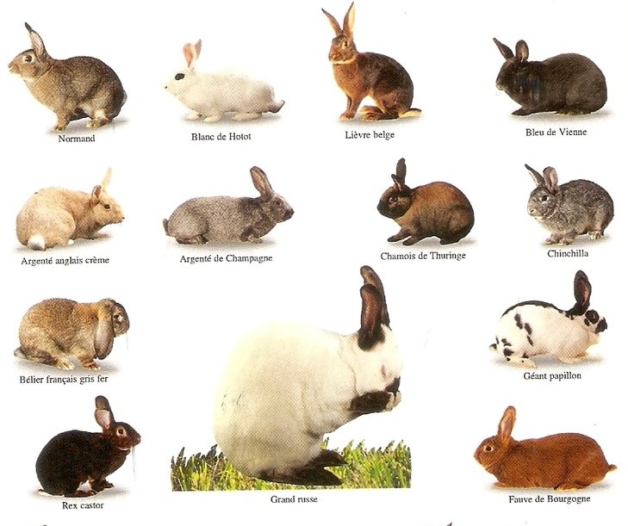
2.2 Defining Classes Part 2
academy.zariba.com

Slide 2
Lecture Content
BunniesVersusZombies Code Review
Namespaces
Structures
Generics, indexers and operator overloading

Slide 3




1. Code Review
Bunnies
Zombies

Slide 4
2. Namespaces
Bunnies
Zombies

Slide 5
3. Structures
What is a structure in C#?
Unlike classes, structures are value types.
Structures behave like primitive types (int, double…)
Structures can have properties, methods, fields, constructors, events, etc.
Mostly used to store data (fields), e.g. points in 2D, 3D space

Slide 6

4. Generics, indexers and operator overloading

Slide 7
Homework
Organize your previous homework into separate files, namespaces and folders. Decouple your classes with the Console. Fix all StyleCop errors that arise.
Create a class Fraction with the properties/fields numerator, denominator, value (string which will return for example “1/2”) and decimal value (e.g. “0.5”). Perform the necessary validations when creating a new Fraction. Overload the operators “+”, “-”, “*”, “/”. Test your application with different calculations.
Create a class Matrix which corresponds to the mathematical definition of a matrix. Overload the operators “+”, “-” and “*”. Check if those operations can be performed at all (validation). Test all of your operations.
Create your own Generic List (called myList). Implement the following: Accessing by index, removing element by index, inserting element at a given position, adding an element to the list, clearing the list, finding element by value and ToString().

Slide 8

References

Slide 9



Zariba Academy
Questions

